Slide 1
SUPPORT VECTOR MACHINE

Slide 2
Classification Problem
A pattern classification problem can be formulated as follows:
A large, perhaps infinite, set of objects (observations, patterns, etc.) which can be classified into two classes (that is, assigned to two sets).
We do not have an algorithm that does this classification, but we have a sample of objects with known class labels.
Using these classification examples, we want to define an algorithm that will classify objects from the entire set with the minimum error.

Slide 3
Objects in a classification problem are represented by vectors from some vector space V .
In most practical applications vector space V is simply the n-dimensional real coordinate space R^{n}.
In this space, vector x is a set of n real numbers x_{i} called the components of the vector:
x = (x₁, x₂, …, x_{n}).
A sample Training set of objects with known class labels is called a training set and is written as:
(x₁, y₁), (x₂, y₂), … , (x_{l}, y_{l}).
where y_{i} ϵ {-1, 1} is the class label of vector xi, and l is the size of the training set.

Slide 4
A classification algorithm (classifier) is represented by a decision function:
f(x): V -> {-1, 1}
such that f(x) = 1 if the classifier assigns x to the first class, and f(x) = -1 if the classifier assigns x to the second class.

Slide 5
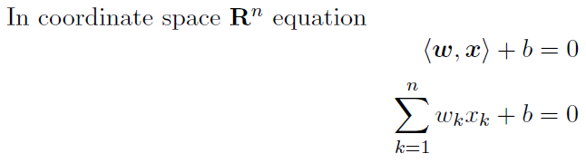
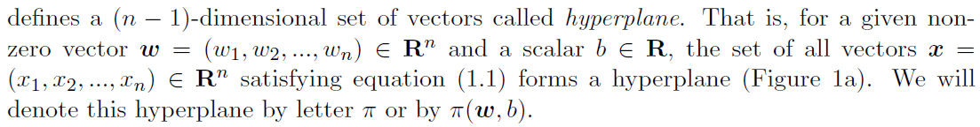
Equation of a hyperplane

Slide 6
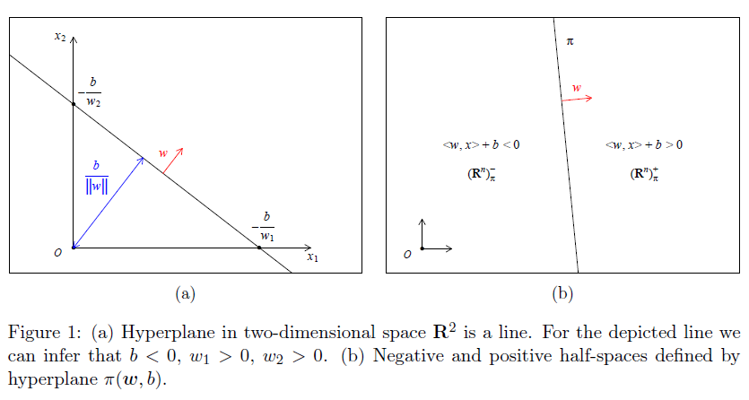

Slide 7
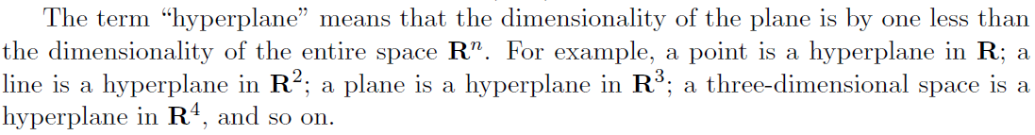
Vector w is called the normal vector of the hyperplane, and number b is called the intercept of the hyperplane.
The normal vector defines the orientation of the hyperplane in space, while the ratio between ||w|| and b (not the intercept alone) defines the distance between the hyperplane and the origin of space.
The normal vector is perpendicular to all vectors parallel to the hyperplane.

Slide 8
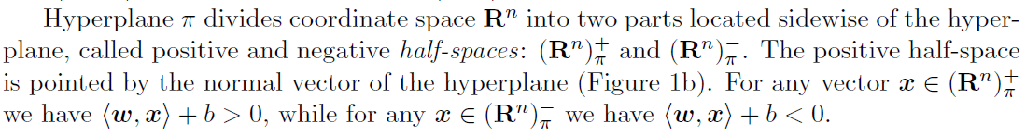
That is, if z = x1 - x2 such that <w, x1> + b’ = 0 and <w, x2> + b’ = 0 for some b’ then <w, z> = 0.
Notes:
The origin of space is zero vector 0 = (0, 0, …, 0); in figures, we denote it by capital letter O.

Slide 9
A Single Hyperplane is defined by infinite number of parameters w, b.
Indeed, multiplying equation (1.1) by arbitrary constant c ≠ 0 we see that parameters cw, cb define the same hyperplane.
In other words, if two hyperplanes Π₁ and Π₂ are defined by parameters w₁, b₁ and w₂, b₂, and w₂ = cw₁, b₂ = cb₁, then Π₁ and Π₂ are the same hyperplanes.
Since we can arbitrary scale parameters w, b defining fixed hyperplane Π, we can choose w, b such that ||w|| = 1.
Note that this pair of parameters is unique for any hyperplane.

Slide 10
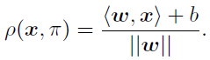
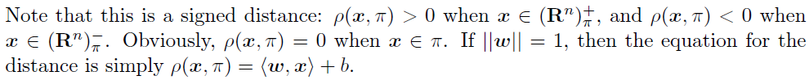
The distance ρ(x, Π) between a vector x and a hyperplane Π(w, b) can be calculated according to the following equation:

Slide 11
It follows from the equation that the distance between the origin of space and hyperplane Π is equal to b/||w||.
This simple fact allows us to make several useful observations regarding the position and orientation of the hyperplane in space, and how parameters b and w affect them.
These observations will help us later in considerations related to the maximum margin hyperplane

Slide 12
A Classification Task usually involves separating data into training and testing sets.
Each instance in the training set contains one “target value” (i.e. the class labels) and several “attributes” (i.e. the features or observed variables).
The goal of SVM is to produce a model (based on the training data) which predicts the target values of the test data given only the test data attributes.

Slide 13
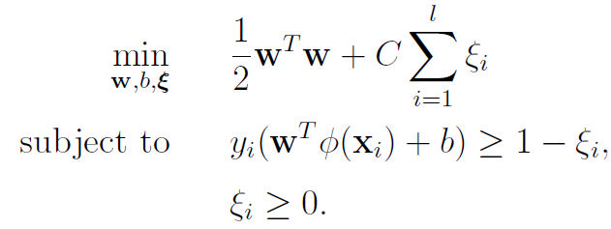
Given a training set of instance-label pairs (xi, yi), i = 1, …, l where xi ϵ R^{n} and y ϵ {-1, 1}^{l}, the support vector machines (SVM) require the solution of the following optimization problem:

Slide 14
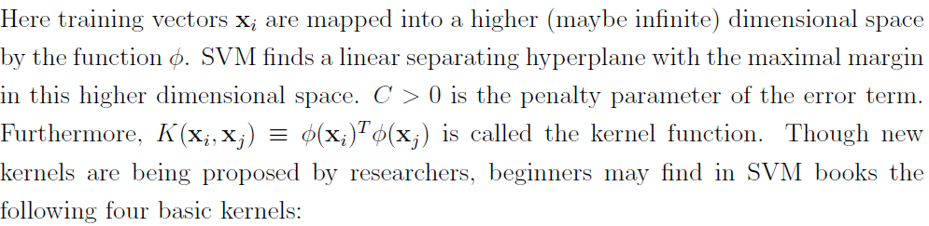
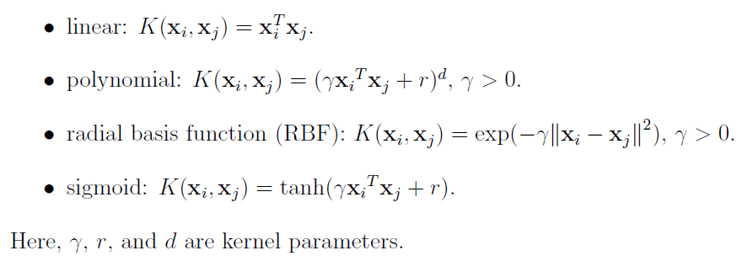

Slide 15
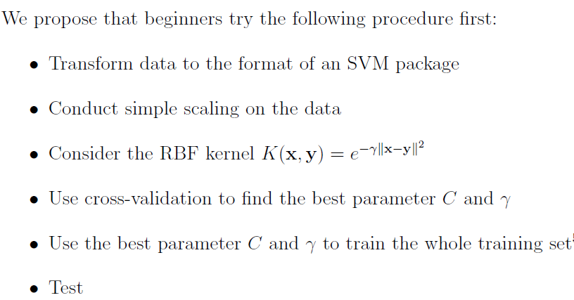

Slide 16
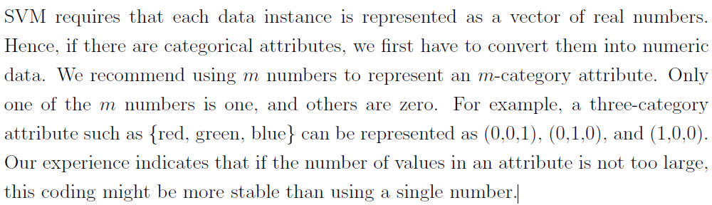
Categorical Features

Slide 17
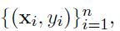
Linear Classifiers
Support vector machines are an example of a linear two-class classifier.
The data for a two class learning problem consists of objects labeled with one of two labels corresponding to the two classes; for convenience we assume the labels are +1
(positive examples) or -1 (negative examples).
x denotes a vector with components x_{i}. The notation x_{i} will denote the ith vector in a dataset
where y_{i} is the label associated with x_{i}.

Slide 18
The objects x_{i} are called Patterns or Examples.
We assume the examples belong to some set X.
Initially we assume the examples are vectors, but once we introduce kernels this assumption will be relaxed, at which point they could be any continuous/discrete object (e.g. a protein/DNA sequence or protein structure).

Slide 19
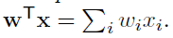
We assume the examples belong to some set X.
Initially we assume the examples are vectors, but once we introduce kernels this assumption will be relaxed, at which point they could be any continuous/discrete object (e.g. a protein/DNA sequence or protein structure).
A key concept required for defining a linear classifier is the dot product between two vectors, also referred to as an inner product or scalar product, defined as:

Slide 20
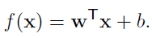
A linear classifier is based on a linear discriminant function of the form:
The vector w is known as the weight vector, and b is called the bias.
Consider the case b = 0 first.
The set of points x such that w^{T}x = 0 are all points that are perpendicular to w and go through the origin - a line in two dimensions, a plane in three dimensions, and more generally, a
hyperplane.
The bias b translates the hyperplane away from the origin.

Slide 21
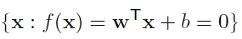
The hyperplane
divides the space into two: the sign of the discriminant function f(x) denotes the side of the
hyperplane a point is on.
The boundary between regions classified as positive and negative is called the decision boundary of the classifier.
The decision boundary defined by a hyperplane is said to be linear because it is linear in the input examples.

Slide 22
A classifier with a linear decision boundary is called a Linear Classifier.
Conversely, when the decision boundary of a classifier depends on the data in a non-linear way the classifier is said to be Non-linear.

Slide 23
Kernels: from Linear to Non-Linear Classifiers
In many applications a non-linear classifier provides better accuracy.
And yet, linear classifiers have advantages, one of them being that they often have simple training algorithms that scale well with the number of examples.
This gives rise to the question: Can the machinery of linear classifiers be extended to generate non-linear decision boundaries?
Furthermore, can we handle domains such as protein sequences or structures where a representation in a fixed dimensional vector space is not available?

Slide 24
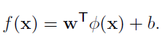

Slide 25
The approach of explicitly computing non-linear features does not scale well with the number
of input features:
When applying the mapping from the above example the dimensionality of the feature space F is quadratic in the dimensionality of the original space.
This results in a quadratic increase in memory usage for storing the features and a quadratic increase in the time required to compute the discriminant function of the classifier.
This quadratic complexity is feasible for low dimensional data; but
when handling gene expression data that can have thousands of dimensions, quadratic complexity in the number of dimensions is not acceptable.

Slide 26
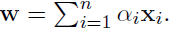
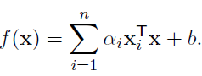
Kernel methods solve this issue by avoiding the step of explicitly mapping the data to a high dimensional feature-space.
Suppose the weight vector can be expressed as a linear combination of the training examples, i.e.
Then:

Slide 27
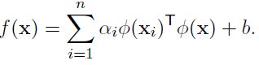
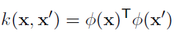
In the feature space, F this expression takes the form:
The representation in terms of the variables α_{i} is known as the dual representation of the decision boundary.
As indicated above, the feature space F may be high dimensional, making this trick impractical unless the kernel function k(x, x’) defined as:

Slide 28
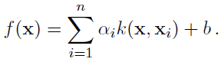
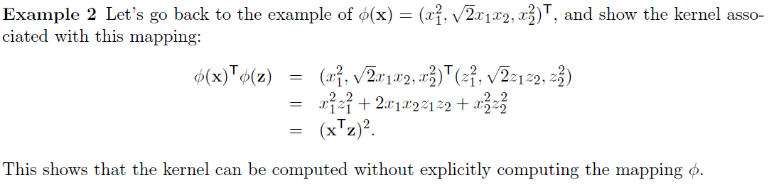
can be computed efficiently.
In terms of the kernel function the discriminant function is:

Slide 29
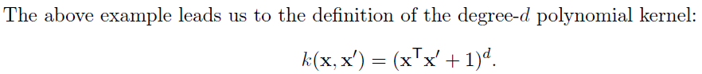
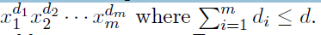
The feature space for this kernel consists of all monomials up to degree d, i.e. features of the form:
The kernel with d = 1 is the linear kernel, and in that case the additive constant in the above equation is usually omitted.

Slide 30
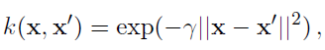
The other widely used kernel is the Gaussian kernel defined by:
where ϒ > 0 is a parameter that controls the width of Gaussian.
It plays a similar role as the degree of the polynomial kernel in controlling the flexibility of the resulting classifier

Slide 31
We saw that a linear decision boundary can be “Kernelized”, i.e. its dependence on the data
is only through dot products.
In order for this to be useful, the training algorithms needs to be kernelizable as well.
It turns out that a large number of machine learning algorithms can be expressed using kernels - including ridge regression, the perceptron algorithm, and SVMs.

Slide 32
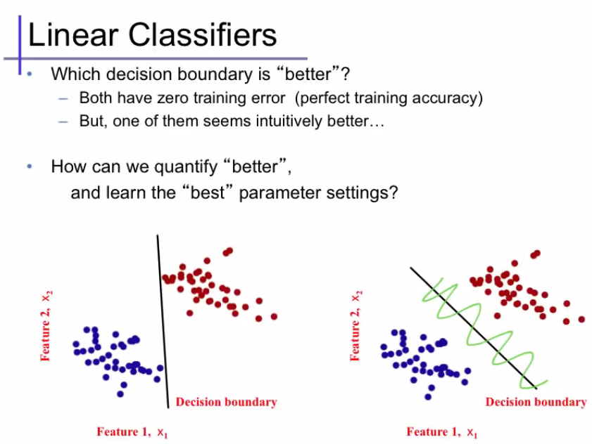

Slide 33
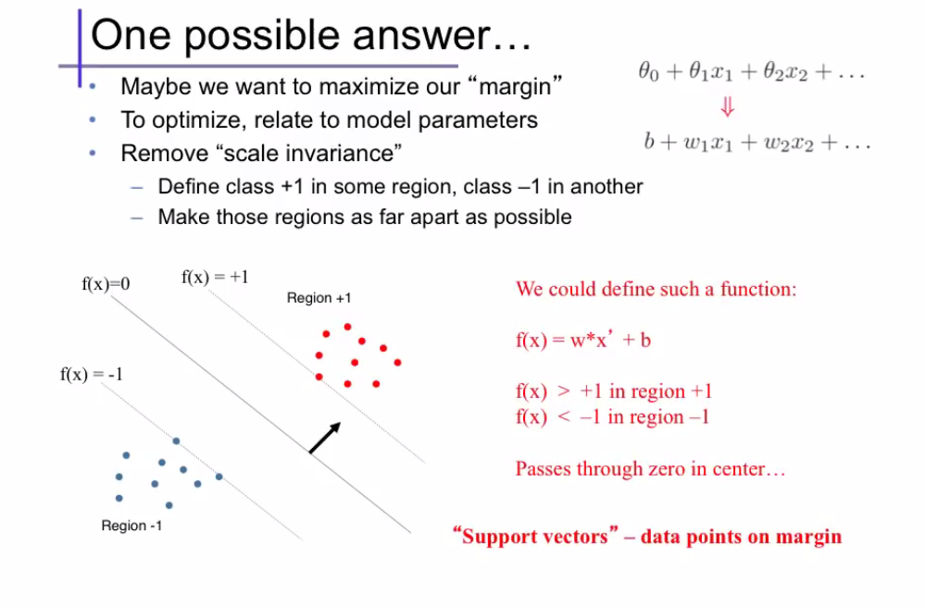

Slide 35
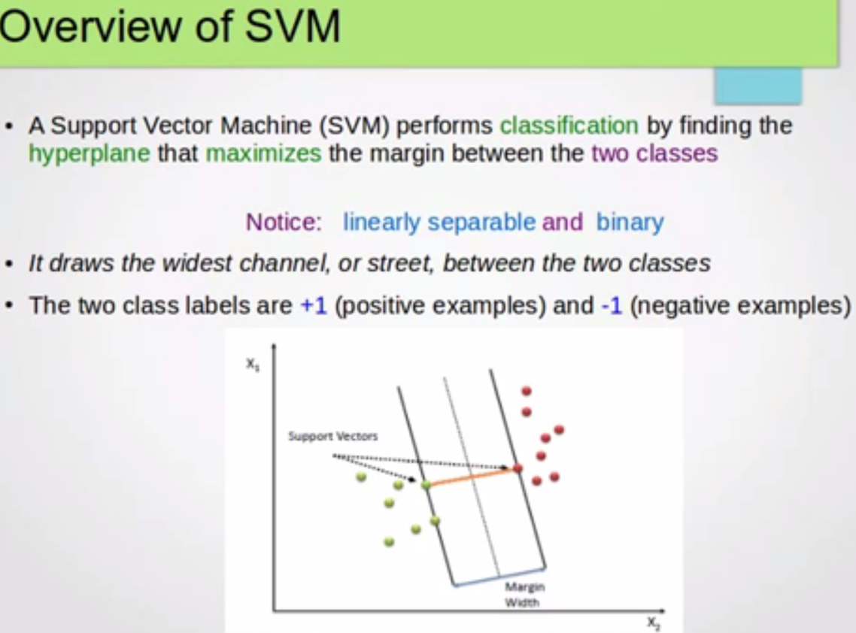

Slide 36
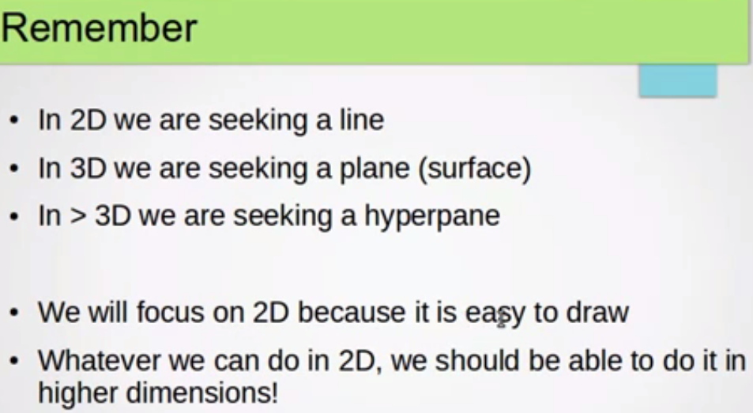

Slide 37
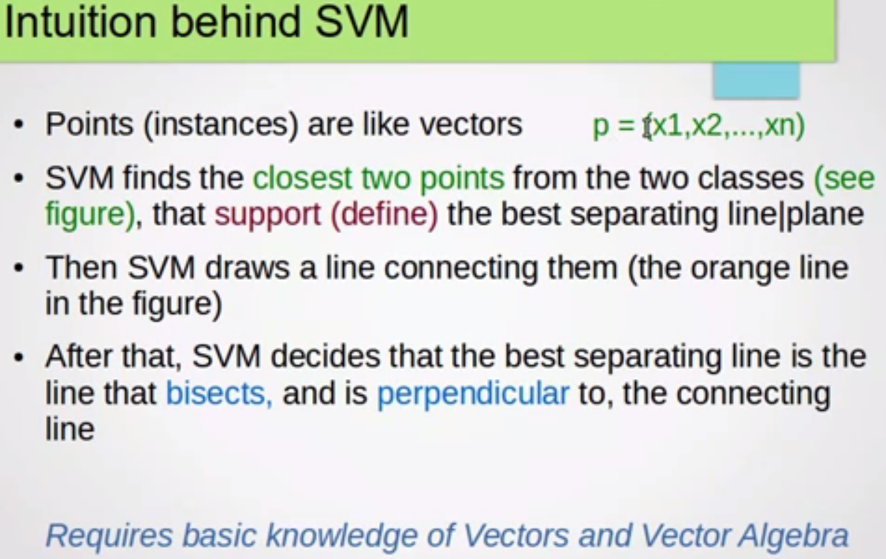

Slide 38


Slide 39
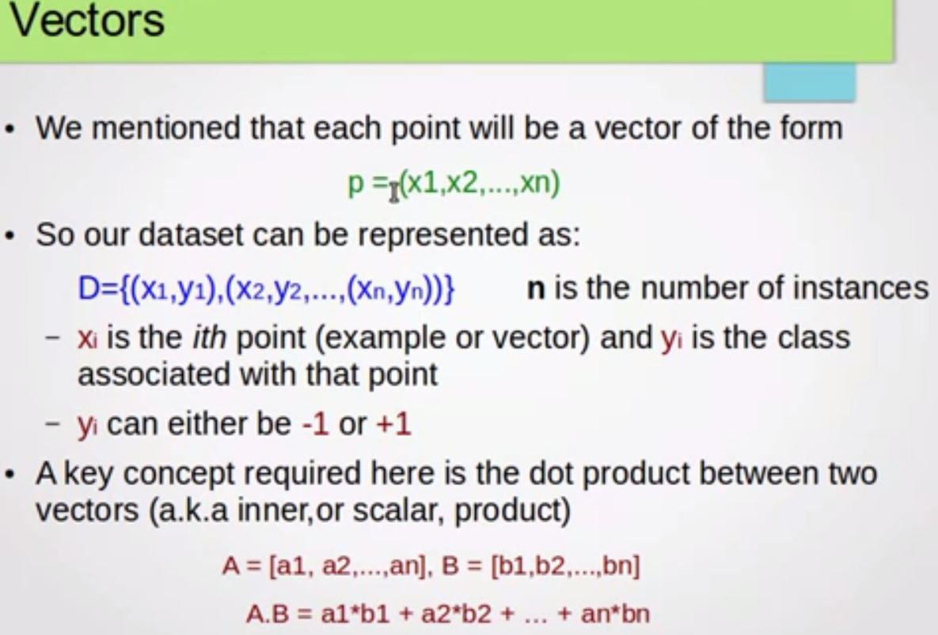

Slide 40
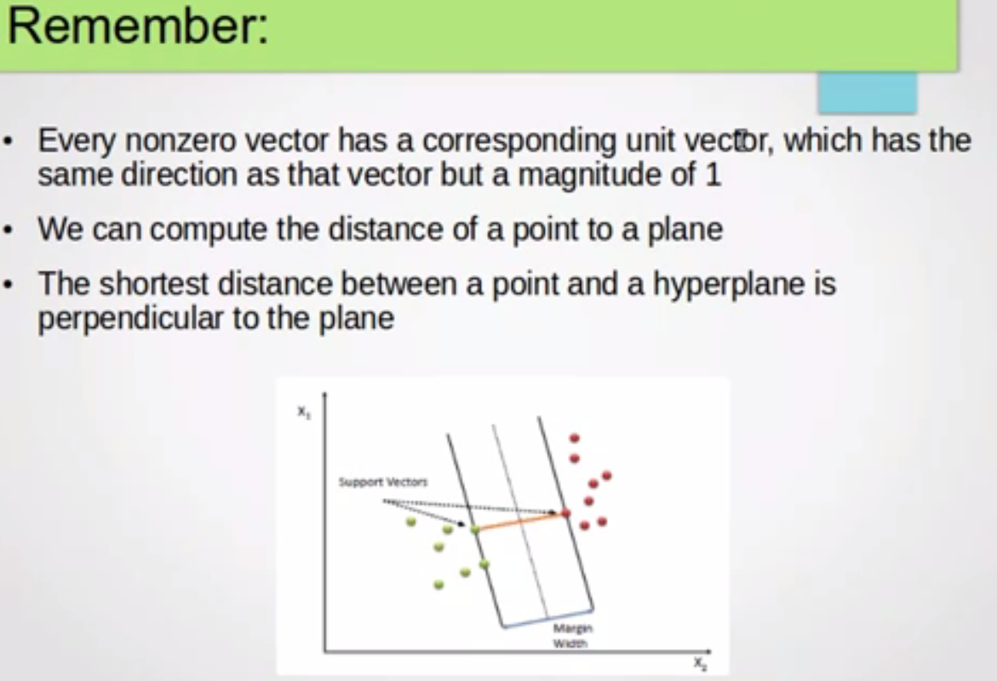

Slide 41
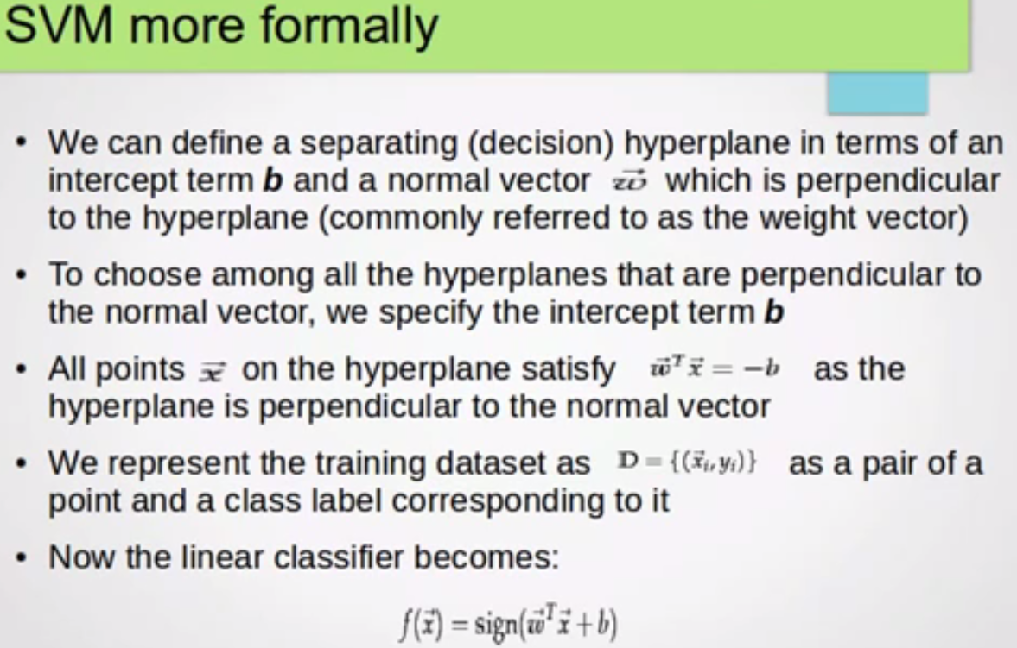

Slide 42
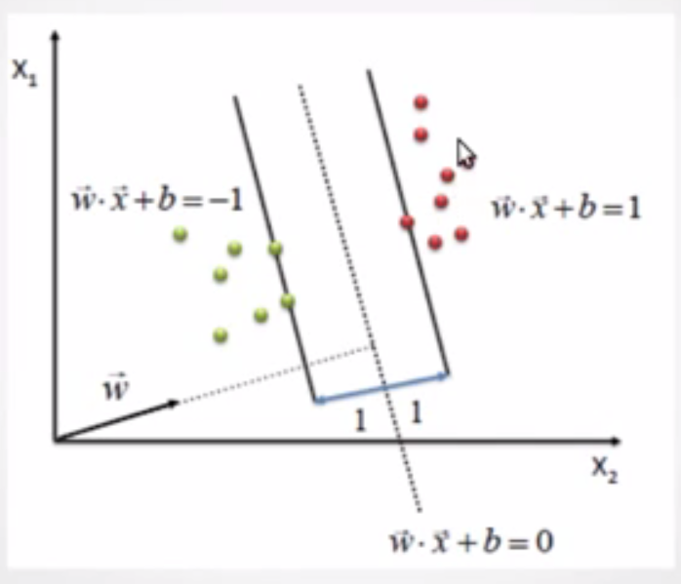

Slide 43


Slide 44
Using SVMs effectively requires an understanding of how they work.
When training an SVM the practitioner needs to make a number of decisions: how to preprocess the data, what kernel to use, and finally, setting the parameters of the SVM and the kernel.

Slide 45
The Support Vector Machine (SVM) is a state-of-the-art classication method introduced in 1992 by Boser, Guyon, and Vapnik.
The SVM classier is widely used in bioinformatics (and other disciplines) due to its high accuracy, ability to deal with high-dimensional data such as gene expression, and flexibility in modeling diverse sources of data.
SVMs belong to the general category of kernel methods.
A kernel method is an algorithm that depends on the data only through dot-products.

Slide 46
When this is the case, the dot product can be replaced by a kernel function which computes a dot product in some possibly high dimensional feature space.
This has two advantages:
The ability to generate non-linear decision boundaries using methods designed for linear classifiers.
The use of kernel functions allows the user to apply a classier to data that have no obvious fixed-dimensional vector space representation.
The prime example of such data in bioinformatics are sequence, either DNA or protein, and protein structure.

Slide 47
Using SVMs effectively requires an understanding of how they work.
When training an SVM the practitioner needs to make a number of decisions:
how to preprocess the data,
what kernel to use, and
finally, setting the parameters of the SVM and the kernel.

Slide 48
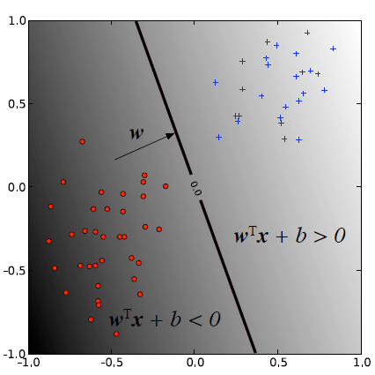
Figure 1: A linear classifier. The decision boundary (points x such that wTx + b = 0) divides the plane into two sets depending on the sign of wTx + b.

